Slide 1
Lung Cancer Prediction
By
BARANI R (2019239003)
SAI PRAVEEN KUMAR S (2019242016)
DEEPAKUMAR P(2019239005)
KISHANTH P(2019239013)
PURUSHOTHAMAN A R (2019239019)

Slide 2
PROBLEM STATEMENT
Lung cancer is the leading cause of cancer death worldwide, accounting for 1.59 million deaths in 2018. The majority of lung cancer cases are attributed to smoking, but exposure to air pollution is also a risk factor. A new study has found that air pollution may be linked to an increased risk of lung cancer, even in nonsmokers.
The study, which was published in the journal Nature Medicine, looked at data from over 462,000 people in China who were followed for an average of six years. The participants were divided into two groups: those who lived in areas with high levels of air pollution and those who lived in areas with low levels of air pollution.

Slide 3
PROBLEM STATEMENT
The researchers found that the people in the high-pollution group were more likely to develop lung cancer than those in the low-pollution group. They also found that the risk was higher in nonsmokers than smokers, and that the risk increased with age.
While this study does not prove that air pollution causes lung cancer, it does suggest that there may be a link between the two. More research is needed to confirm these findings and to determine what effect different types and levels of air pollution may have on lung cancer risk

Slide 4
PROBLEM STATEMENT
Late-stage Diagnosis:
A significant number of lung cancer cases are identified at advanced stages, impacting treatment outcomes.
Diagnostic Ambiguity:
Variability in interpretation of radiological images leads to uncertainties in lung cancer diagnosis.
Resource Disparities:
Inequitable access to specialized healthcare professionals and diagnostic facilities exacerbates diagnostic delays.
Underutilization of Technology:
Limited integration of advanced technologies, like AI, impedes the optimization of diagnostic processes.

Slide 5
OBJECTIVE
Develop a cutting-edge intelligent lung cancer detection system that empowers medical professionals with enhanced accuracy, streamlined workflow, and interpretable AI-driven insights, revolutionizing lung cancer detection.

Slide 6
LUNG CANCER DETECTION
Lung cancer prediction using multiple machine learning classification models using Scikit-learn library in Python is a code implementation that aims to develop a predictive model for detecting lung cancer in patients. The code uses 4 different machine learning algorithms, including logistic regression, decision tree, k-nearest neighbor and Gaussian naive Bayes to predict the likelihood of lung cancer based on a range of variables.

Slide 7
DATASET - SURVEY LUNG CANCER.CSV
The effectiveness of the cancer prediction system helps people to know their cancer risk at a low cost and it also helps the people to take the appropriate decision based on their cancer risk status. The data is collected from the website online lung cancer prediction system.
The dataset used in the code includes various columns such as gender, age, smoking, yellow fingers, anxiety, peer pressure, chronic disease, fatigue, allergy, wheezing, alcohol consuming, coughing, shortness of breath, swallowing difficulty, chest pain, and lung cancer. By analyzing these variables and using machine learning algorithms to identify patterns and correlations, the predictive models can provide accurate assessments of a patient's risk of developing lung cancer.

Slide 8
DATASET - SURVEY LUNG CANCER.CSV
The effectiveness of cancer prediction system helps the people to know their cancer risk with low cost and it also helps the people to take the appropriate decision based on their cancer risk status. The data is collected from the website online lung cancer prediction system .
Total no. of attributes:16 No .of instances:309

Slide 9
DATASET - SURVEY LUNG CANCER.CSV
1. Gender: M(male), F(female) | 2. Age: Age of the patient
3. Smoking: YES=2 , NO=1 | 4. Yellow fingers: YES=2 , NO=1
5. Anxiety: YES=2 , NO=1 | 6. Peer Pressure: YES=2 , NO=1
7. Chronic Disease: YES=2 , NO=1 | 8. Fatigue: YES=2 , NO=1
9. Allergy: YES=2 , NO=1 | 10. Wheezing: YES=2 , NO=1
11. Alcohol: YES=2 , NO=1 | 12. Coughing: YES=2 , NO=1
13. Shortness of Breath: YES=2 , NO=1 | 14. Swallowing Difficulty: YES=2, NO=1
15. Chest pain: YES=2 , NO=1 | 16. Lung Cancer: YES , NO

Slide 10
PRE – PROCESSING DATA
In this dataset, GENDER & LUNG_CANCER attributes are in object data type. So, let's convert them to numerical values using LabelEncoder from sk learn.
Label Encoder is a utility class to help normalize labels such that they contain only values between 0 and n_classes-1.
It can also be used to transform non-numerical labels (as long as they are hashable and comparable) to numerical labels. Also let's make every other attributes as YES=1 & NO=0.

Slide 11
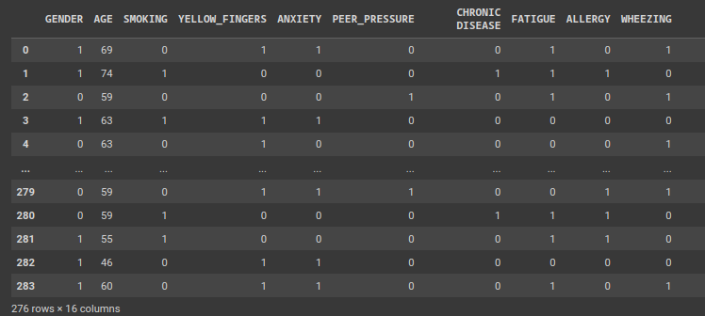
PRE – PROCESSING DATA

Slide 12
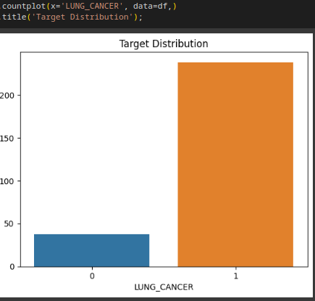
TARGET DISTRIBUTION
1 - 238
0 – 38

Slide 13

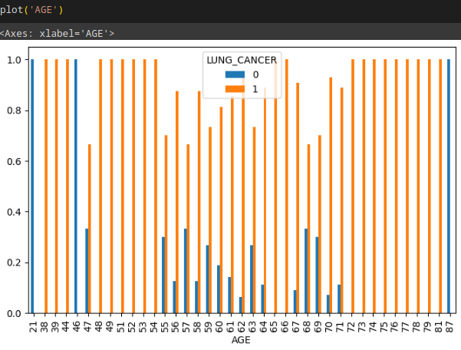
DATA VISUALIZATION

Slide 14
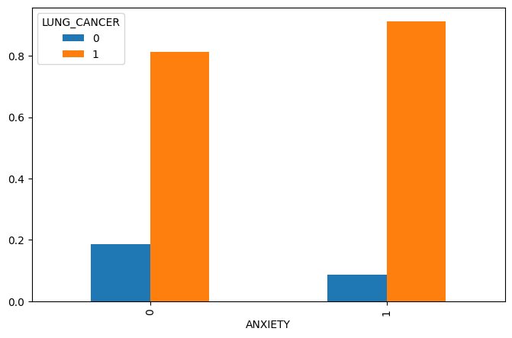
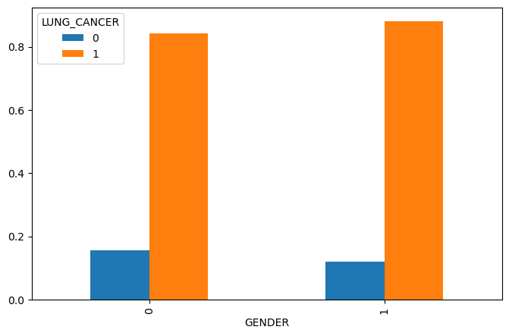
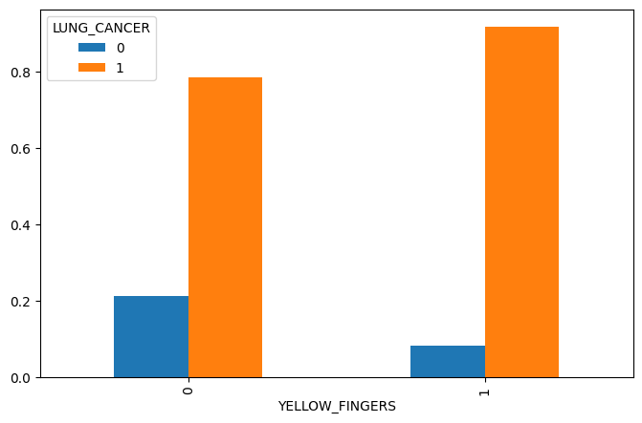
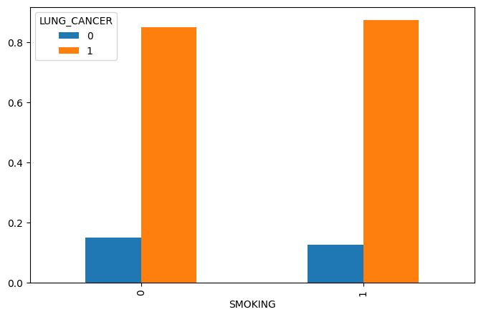

Slide 15
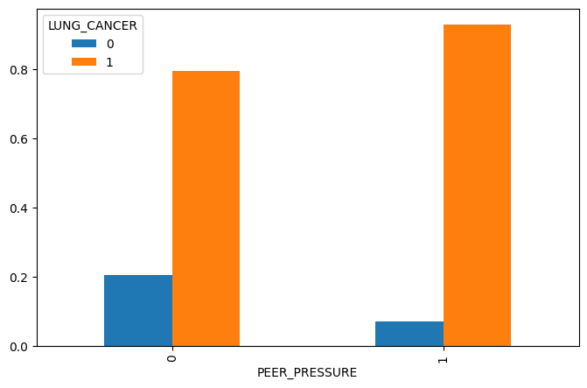
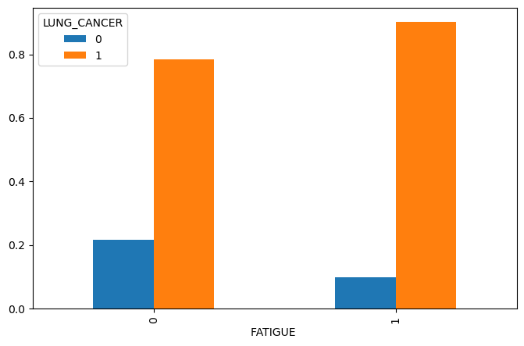

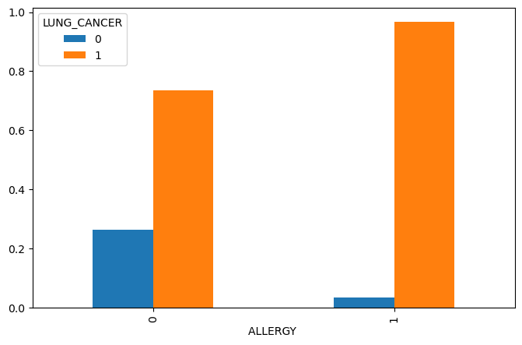

Slide 16
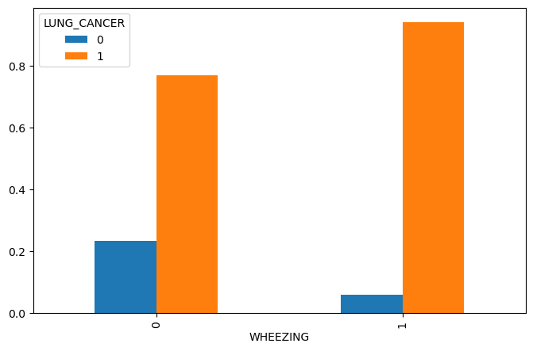
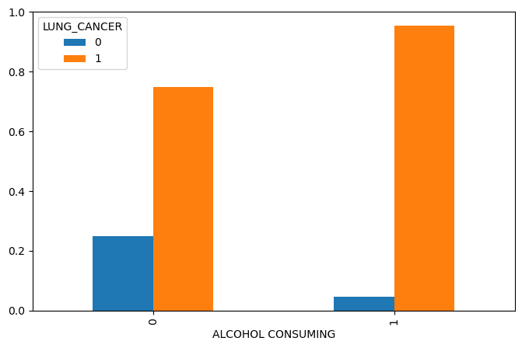
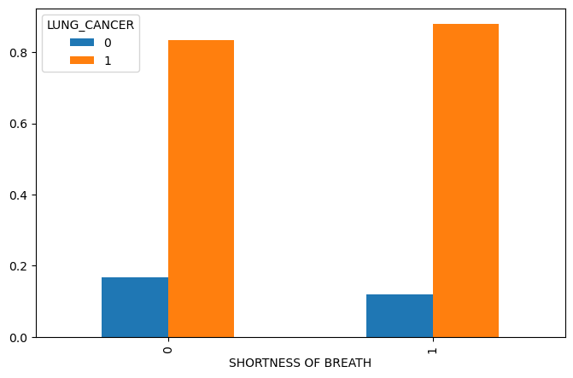
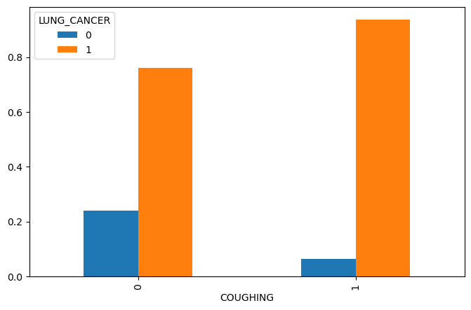

Slide 17
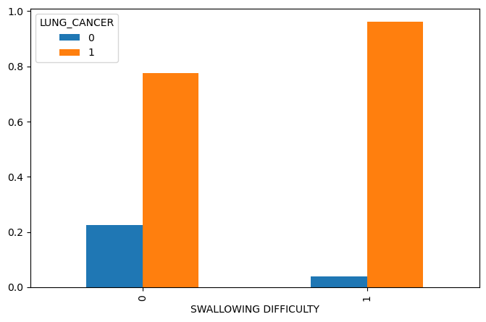
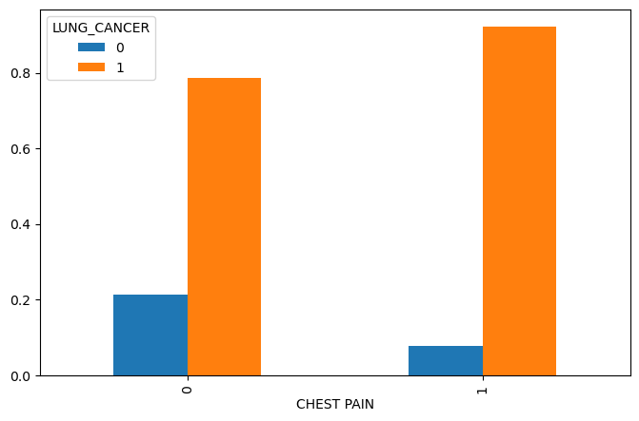
From the visualizations, it is clear that in the given dataset, the features GENDER, AGE, SMOKING and SHORTNESS OF BREATH don't have that much relationship with LUNG CANCER. So let's drop those features to make this dataset more clean

Slide 18
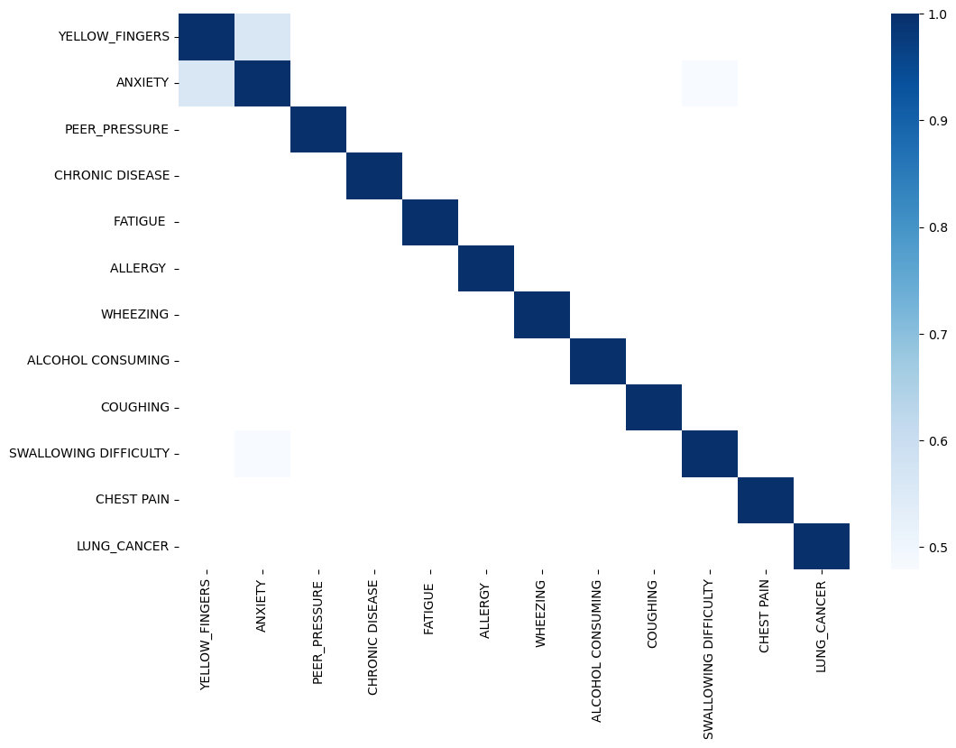

CORRELATION

Slide 19
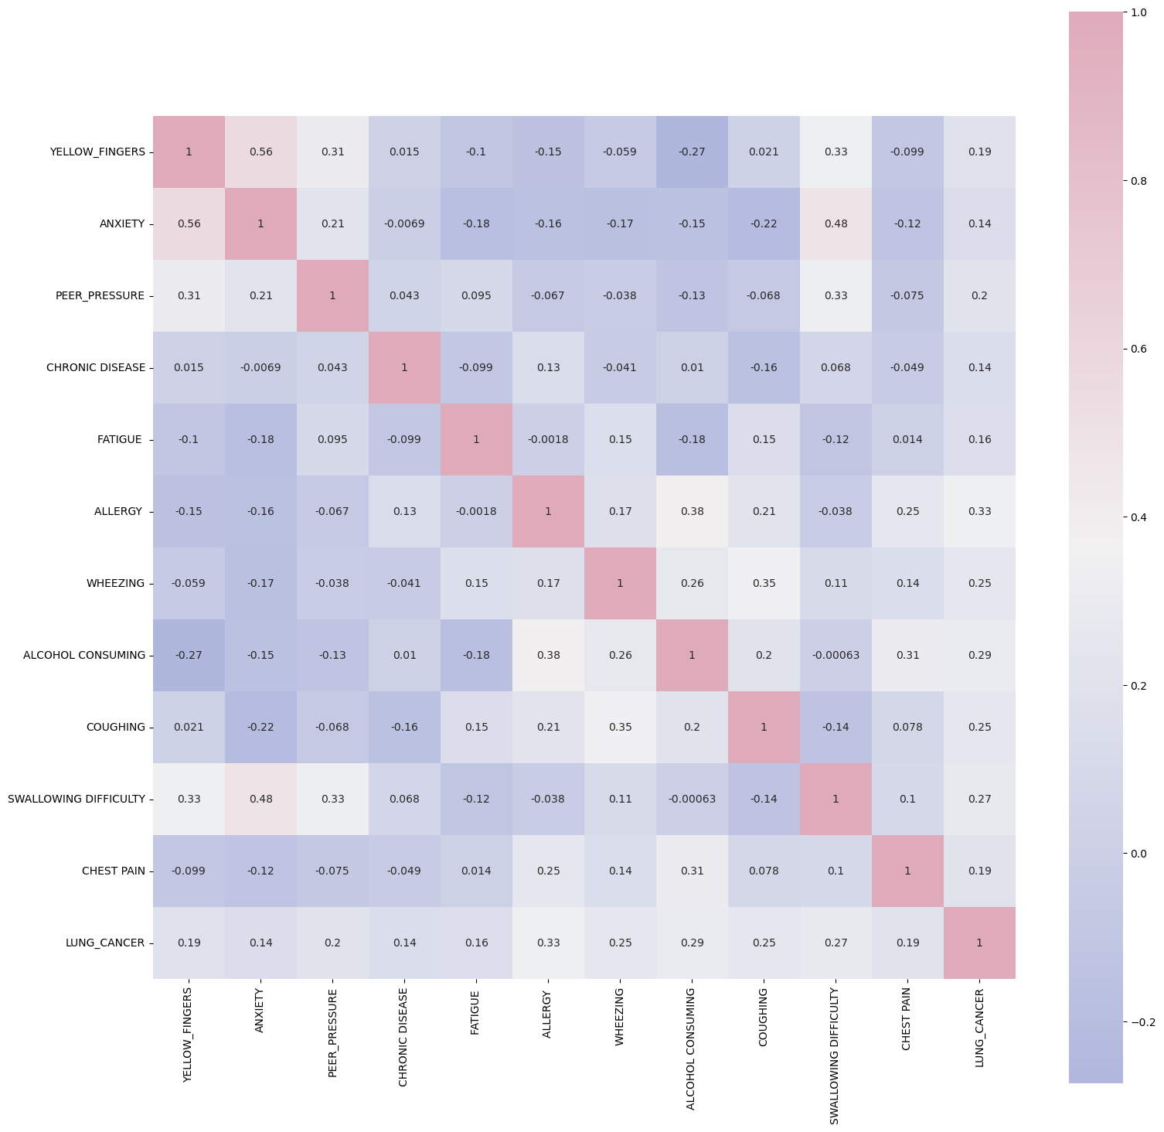

CORRELATION

Slide 20
CORRELATION

Slide 21

FEATURE ENGINEERING
It is the process of creating new features using existing features.
The correlation matrix shows that ANXIETY and YELLOW_FINGERS are correlated more than 50%. So, lets create a new feature combining them.

Slide 22
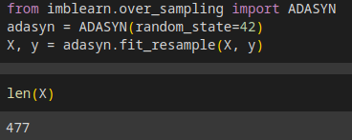
TARGET DISTRIBUTION IMBALANCE HANDLING
Target distribution imbalance handling is the process of addressing the problem of imbalanced data in machine learning. Imbalanced data occurs when the target variable has a very uneven distribution of values, with one or more classes being significantly underrepresented compared to the others.

Slide 23
LOGISTIC REGRESSION
Logistic regression is one of the most popular Machine Learning algorithms, which comes under the Supervised Learning technique. It is used for predicting the categorical dependent variable using a given set of independent variables.
Logistic regression predicts the output of a categorical dependent variable. Therefore the outcome must be a categorical or discrete value. It can be either Yes or No, 0 or 1, true or False, etc. but instead of giving the exact value as 0 and 1, it gives the probabilistic values which lie between 0 and 1.
Logistic Regression is much similar to the Linear Regression except that how they are used. Linear Regression is used for solving Regression problems, whereas Logistic regression is used for solving the classification problems.
In Logistic regression, instead of fitting a regression line, we fit an "S" shaped logistic function, which predicts two maximum values (0 or 1).

Slide 24
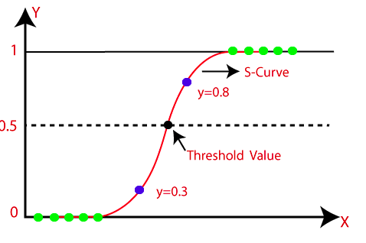
LOGISTIC REGRESSION
The curve from the logistic function indicates the likelihood of something such as whether the cells are cancerous or not, a mouse is obese or not based on its weight, etc.
Logistic Regression is a significant machine learning algorithm because it has the ability to provide probabilities and classify new data using continuous and discrete datasets.
Logistic Regression can be used to classify the observations using different types of data and can easily determine the most effective variables used for the classification. The below image is showing the logistic function:

Slide 25
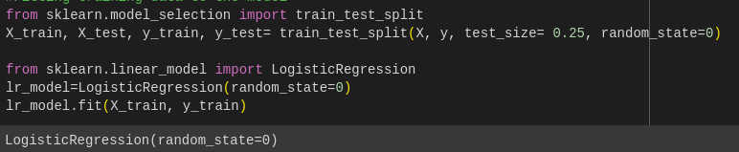
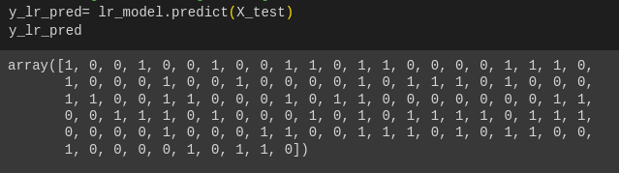
LOGISTIC REGRESSION

Slide 26
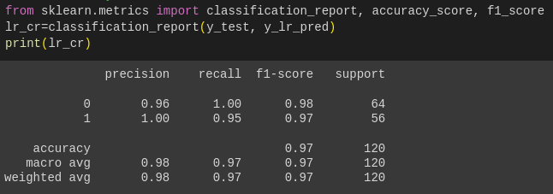

Slide 27
DECISION TREE
Decision Tree is a Supervised learning technique that can be used for both classification and Regression problems, but mostly it is preferred for solving Classification problems. It is a tree-structured classifier, where internal nodes represent the features of a dataset, branches represent the decision rules and each leaf node represents the outcome.
In a Decision tree, there are two nodes, which are the Decision Node and Leaf Node. Decision nodes are used to make any decision and have multiple branches, whereas Leaf nodes are the output of those decisions and do not contain any further branches.
The decisions or the test are performed on the basis of features of the given dataset.
It is a graphical representation for getting all the possible solutions to a problem/decision based on given conditions.

Slide 28
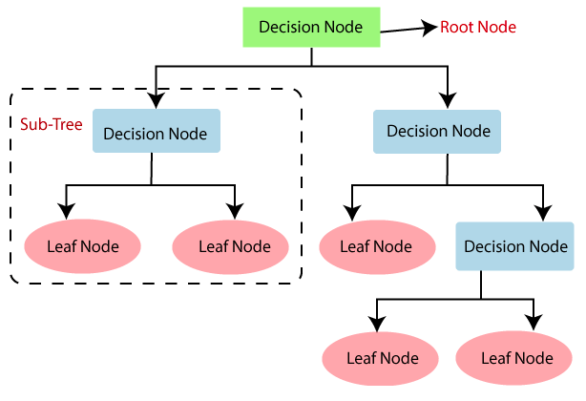
DECISION TREE
It is called a decision tree because, similar to a tree, it starts with the root node, which expands on further branches and constructs a tree-like structure.
In order to build a tree, we use the CART algorithm, which stands for Classification and Regression Tree algorithm.
A decision tree simply asks a question, and based on the answer (Yes/No), it further split the tree into subtrees.

Slide 29
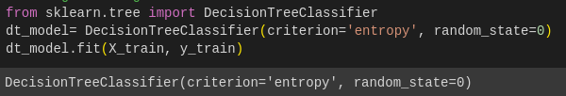
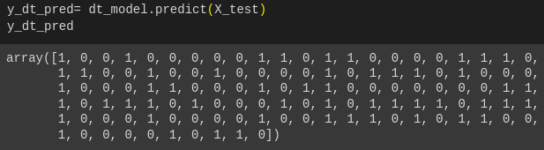
Decision Tree

Slide 30
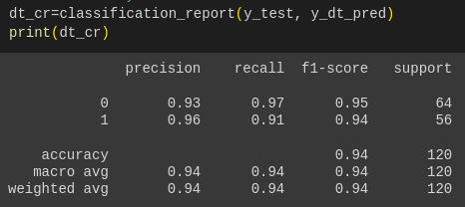
Decision Tree

Slide 31
K NEAREST NEIGHBOUR
K-Nearest Neighbour is one of the simplest Machine Learning algorithms based on Supervised Learning technique.
K-NN algorithm assumes the similarity between the new case/data and available cases and put the new case into the category that is most similar to the available categories.
K-NN algorithm stores all the available data and classifies a new data point based on the similarity. This means when new data appears then it can be easily classified into a well suite category by using K- NN algorithm.
K-NN algorithm can be used for Regression as well as for Classification but mostly it is used for the Classification problems.

Slide 32
K Nearest Neighbour
K-NN is a non-parametric algorithm, which means it does not make any assumption on underlying data.
It is also called a lazy learner algorithm because it does not learn from the training set immediately instead it stores the dataset and at the time of classification, it performs an action on the dataset.
KNN algorithm at the training phase just stores the dataset and when it gets new data, then it classifies that data into a category that is much similar to the new data.

Slide 33
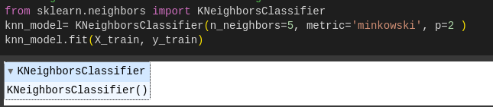
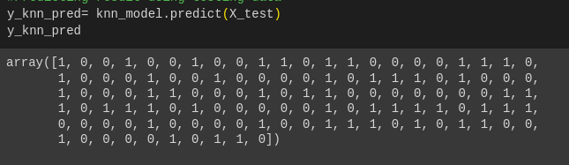
K Nearest Neighbour

Slide 34
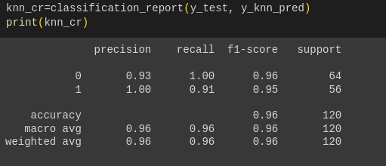
K Nearest Neighbour

Slide 35
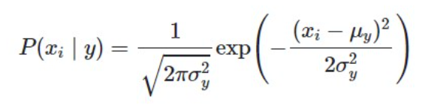
GAUSSIAN NAIVE BAYES
In Gaussian Naïve Bayes, the assumption is made that the continuous numerical attributes are distributed normally. The attribute is first segmented based on the output class, and then the variance and mean of the attribute are calculated for each class.

Slide 36
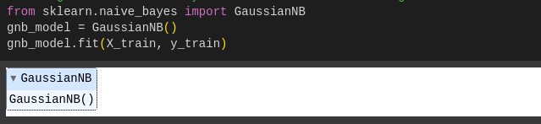
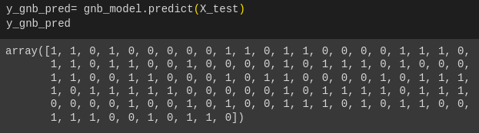
Gaussian Naive Bayes

Slide 37
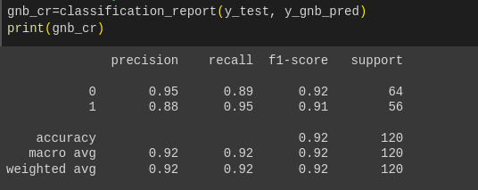
Gaussian Naive Bayes

Slide 38
K FOLD CROSS VALIDATION
K-Fold cross validation is a popular technique used in machine learning for model evaluation and selection. It involves dividing a dataset into K subsets of equal size, called folds. The algorithm then trains and evaluates the model K times, each time using a different fold as the validation set and the remaining K-1 folds as the training set.
During each iteration of K-Fold cross validation, the model is trained on K-1 folds and evaluated on the remaining fold. The performance metrics are then averaged over all K iterations to obtain an estimate of the model's overall performance.

Slide 39
K Fold cross validation
K-Fold cross validation is a robust method for model evaluation because it uses all the available data for training and testing. It also helps to reduce the risk of overfitting and provides a more accurate estimate of the model's performance than using a single training-test split.
Typically, values of K between 5 and 10 are used for K-Fold cross validation, but the optimal value of K may vary depending on the size and complexity of the dataset, as well as the type of model being evaluated.

Slide 40
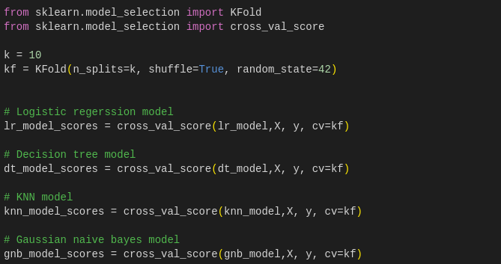
K Fold cross validation

Slide 41
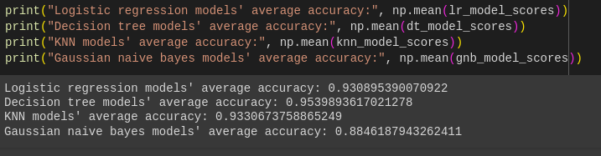
K Fold cross validation

Slide 42
CONCLUSION
The K-Fold cross validation is showing Decision Tree model gives the most accuracy of 95.4%, while Gaussian naive bayes model gives the least accuracy of 88.45%.

Slide 43
REFERENCES
https://www.mdpi.com/2504-2289/6/4/139
https://www.kaggle.com/code/sandragracenelson/lung-cancer-prediction#Cross-Validation
https://www.kaggle.com/code/jorgeromn/lung-cancer-detection-nns-and-decision-tree/notebook#Data-Visualization
https://www.kaggle.com/code/jillanisofttech/lung-cancer-detection-with-high-end-accuracy#Pre-Processing
GITHUB
https://github.com/BARANI2001/lung_cancer

